Slide 1
Differentiable Heightfield Path Tracing with Accelerated Discontinuities
Xiaochun Tong, University of Waterloo
Hsueh-Ti Derek Liu, Roblox
Yotam Gingold, George Mason University
Alec Jacobson, University of Toronto & Adobe Research

Slide 2
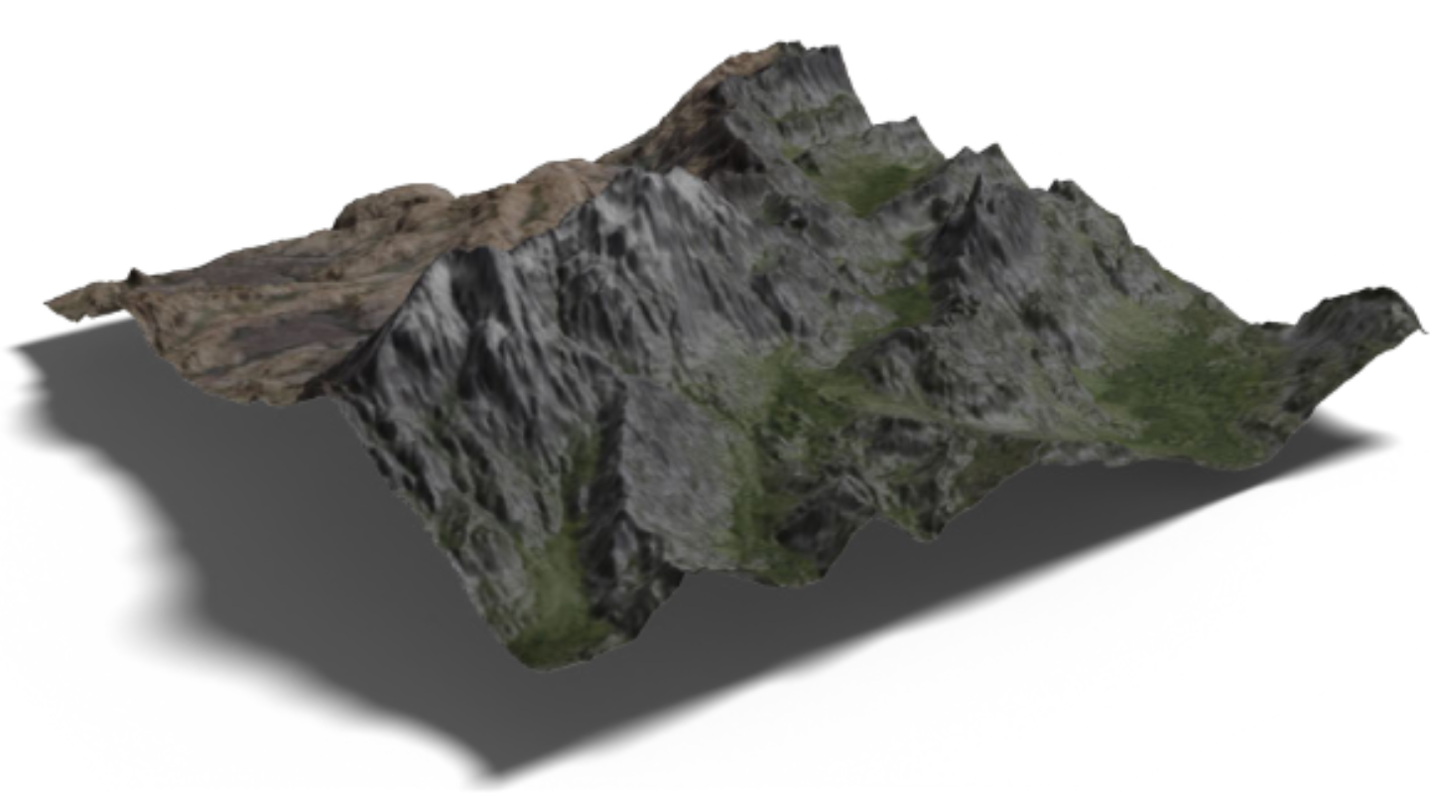
Fast differentiable heightfield renderer

Slide 3
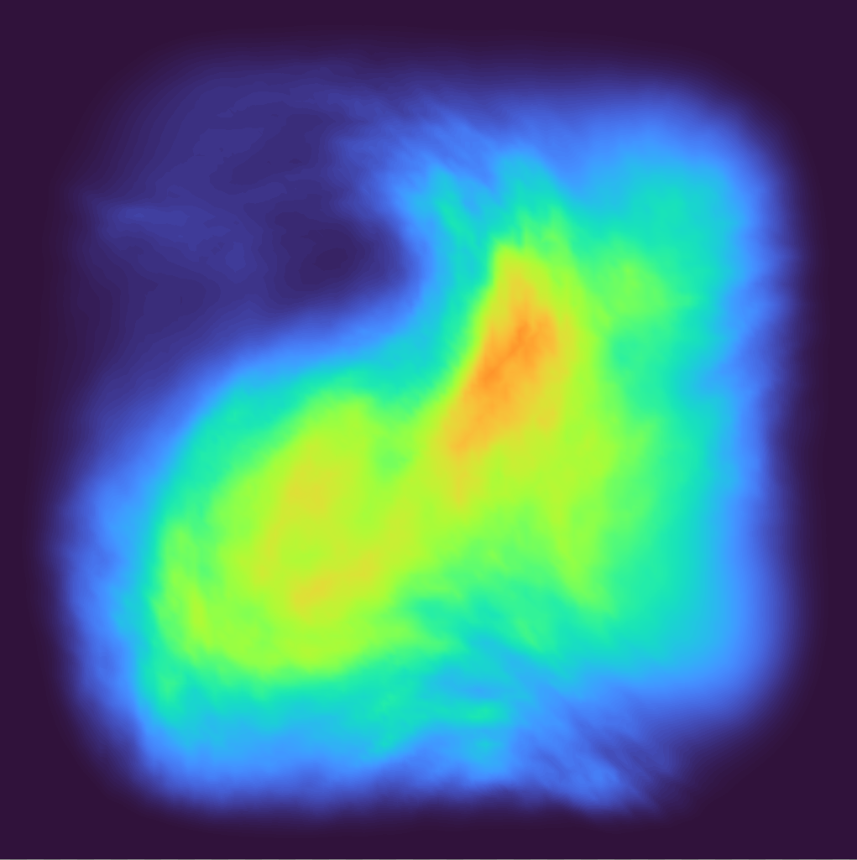
heightfields
Geometry representation using 2D scalar fields
Terrain
Screen space rendering

Slide 4
DISCONTINUITIES ON HEIGHTFIELD
h
x

Slide 5
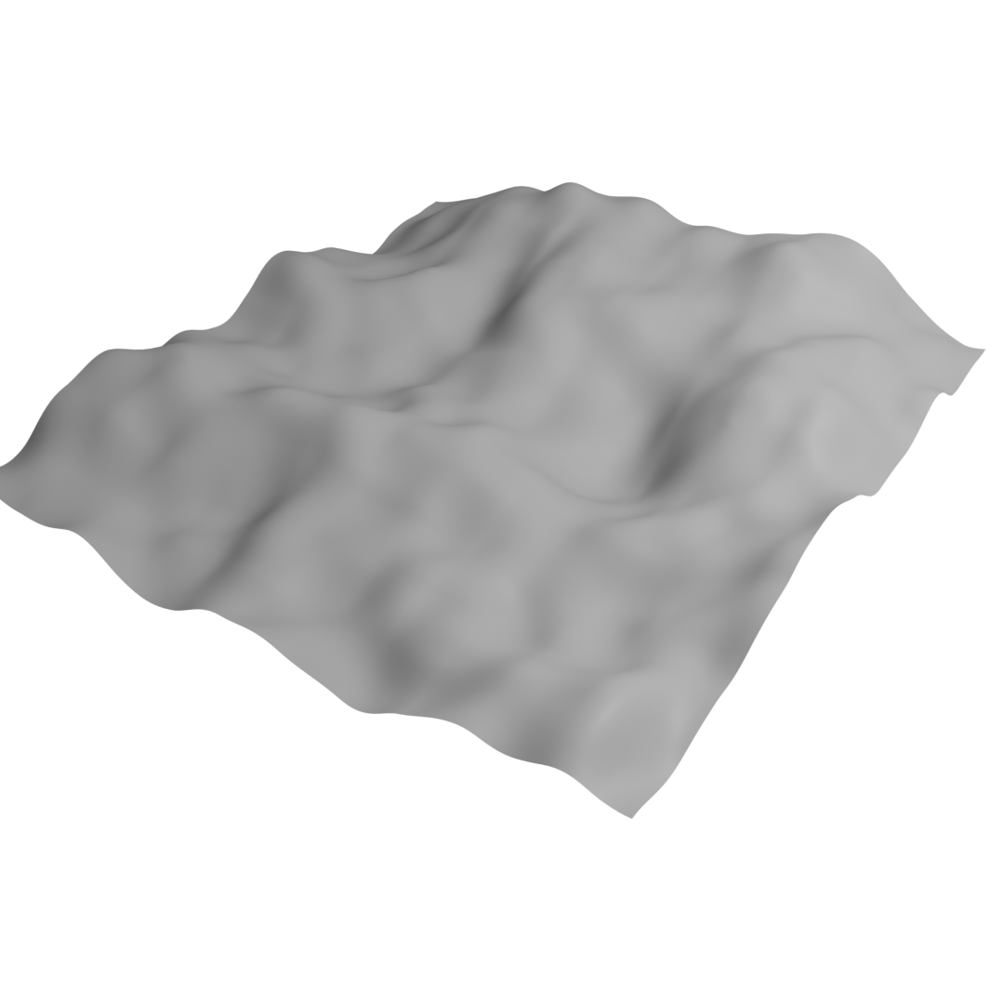
DISCONTINUITIES ON HEIGHTFIELD
h
x

Slide 6
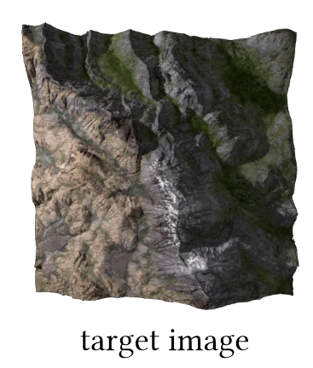
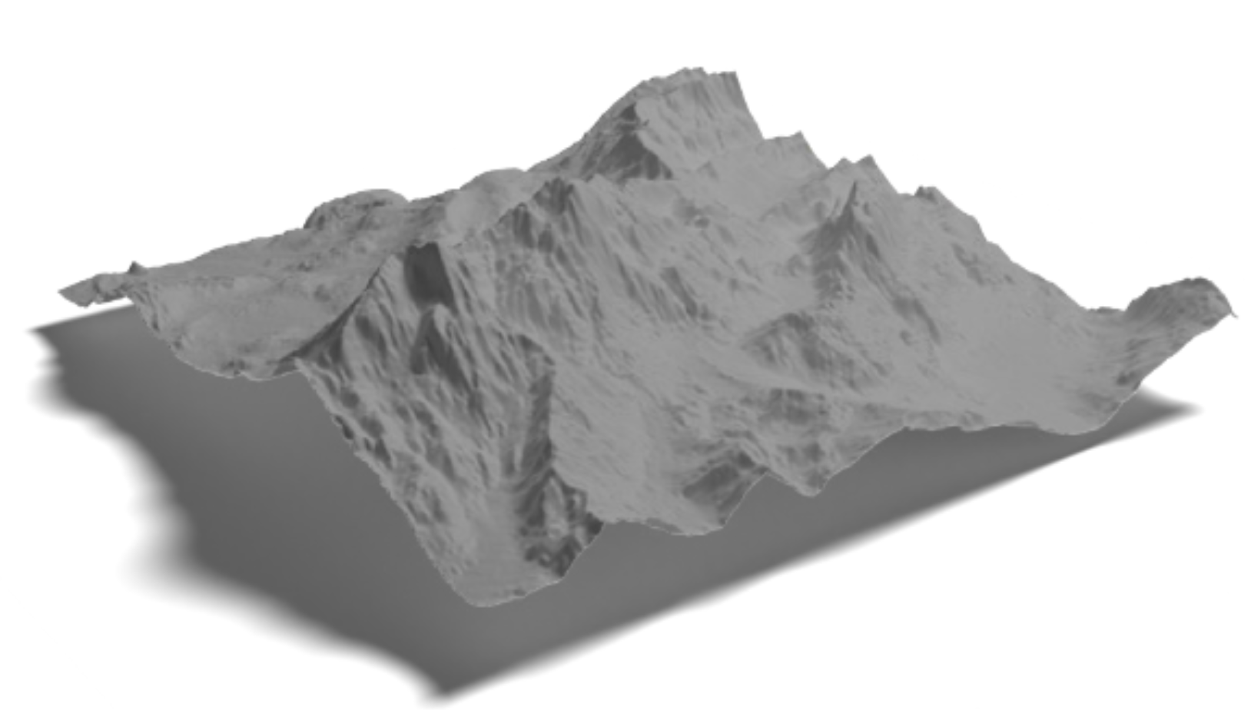
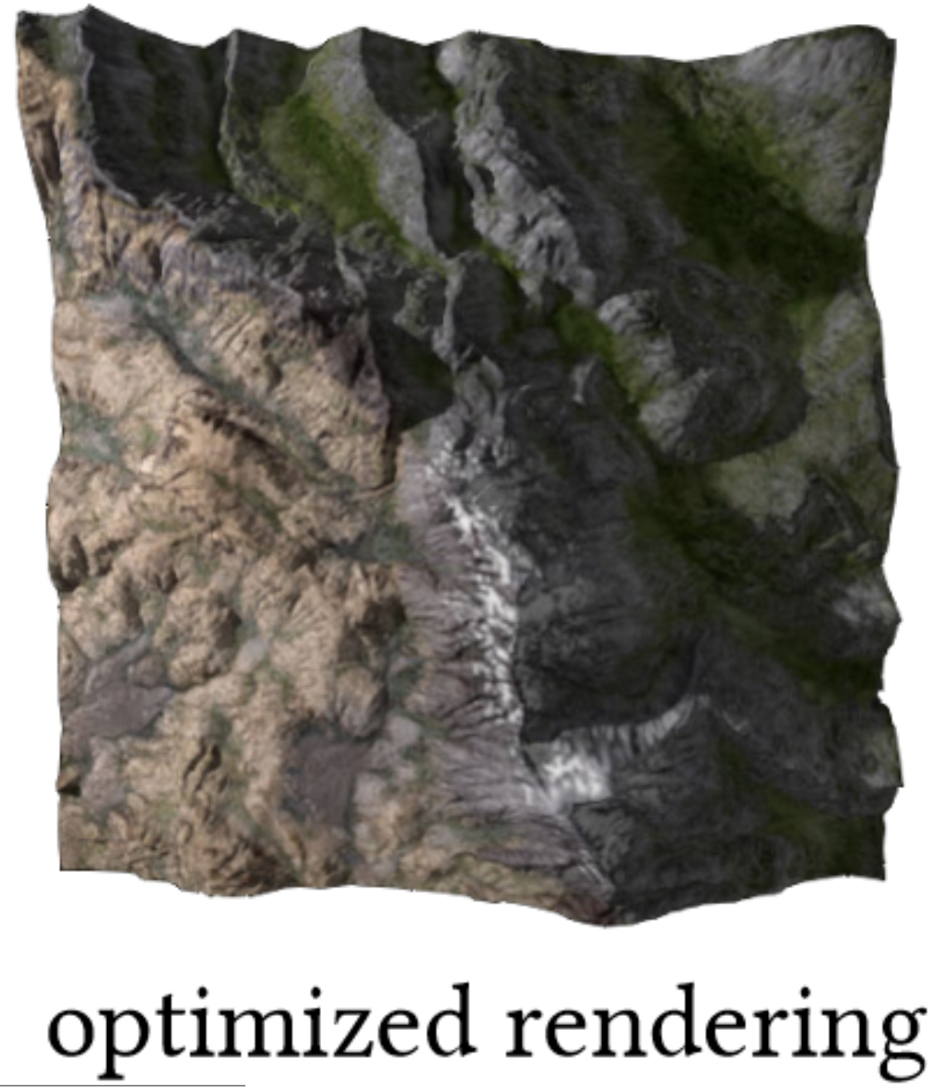
Differentiable heightfield path tracing
Forward pass
Backward pass

Slide 7
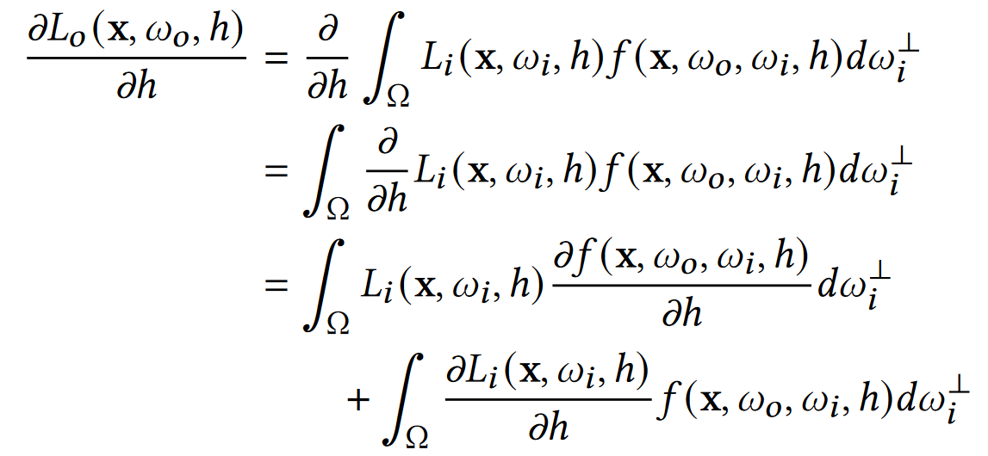
Differentiable heightfield path tracing
Light transport equation
Differentiating continuous integrand is can be done efficiently [Nimier-David et al. 2020; Zeltner et al. 2021]
Bottleneck is differentiating
discontinuities!

Slide 8
DISCONTINUITIES ON HEIGHTFIELD
[Li et al . 2018]

Slide 9
DISCONTINUITIES ON HEIGHTFIELD
[Loubet et al. 2019]

Slide 10
DISCONTINUITIES ON HEIGHTFIELD
θ
φ

Slide 11
DISCONTINUITIES ON HEIGHTFIELD
θ
No vertical edges!
φ

Slide 12
DISCONTINUITIES ON HEIGHTFIELD
θ
φ

Slide 13
DISCONTINUITIES ON HEIGHTFIELD
θ
φ

Slide 14
DISCONTINUITIES ON HEIGHTFIELD
θ
φ

Slide 15
DISCONTINUITIES ON HEIGHTFIELD
0
θ
θ
1
θ
2
φ
𝜋

Slide 16
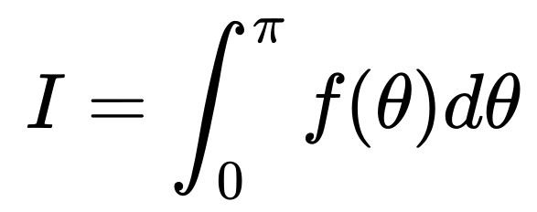
REPARAMETERIZE DISCONTINUITIES
Reparameterization
Make the integral bound independent of scene parameters h
θ
0
θ
1
θ
2
𝜋

Slide 17
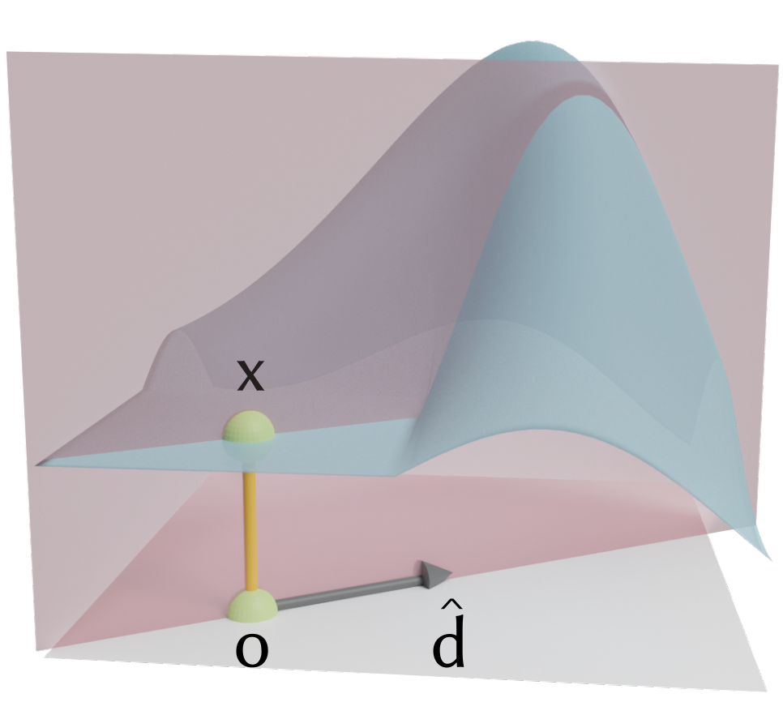
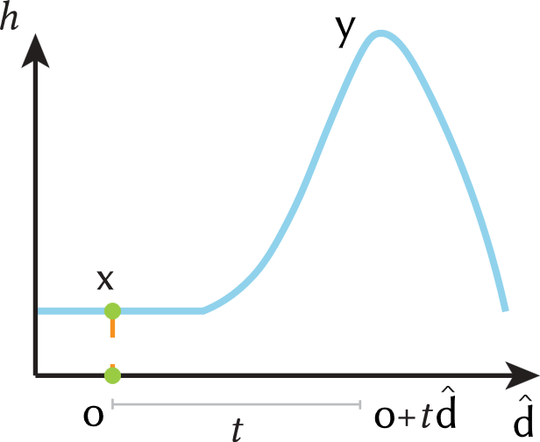
DETERMING DISCONTINUITIES
Discontinuities are points where ray is tangent to the surface

Slide 18
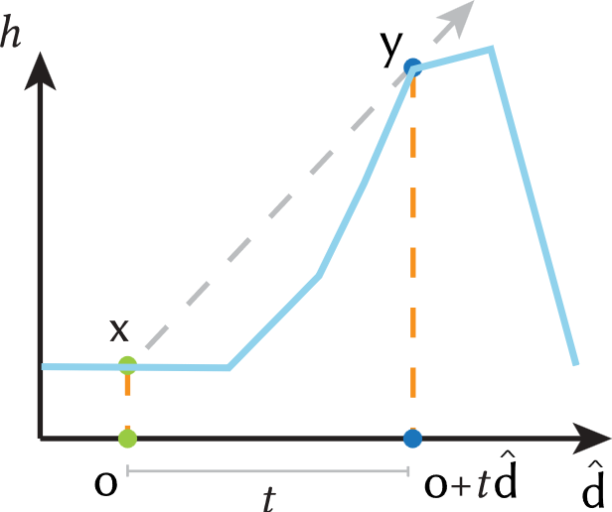
DETERMING DISCONTINUITIES
Discontinuities are points where ray is tangent to the surface

Slide 19
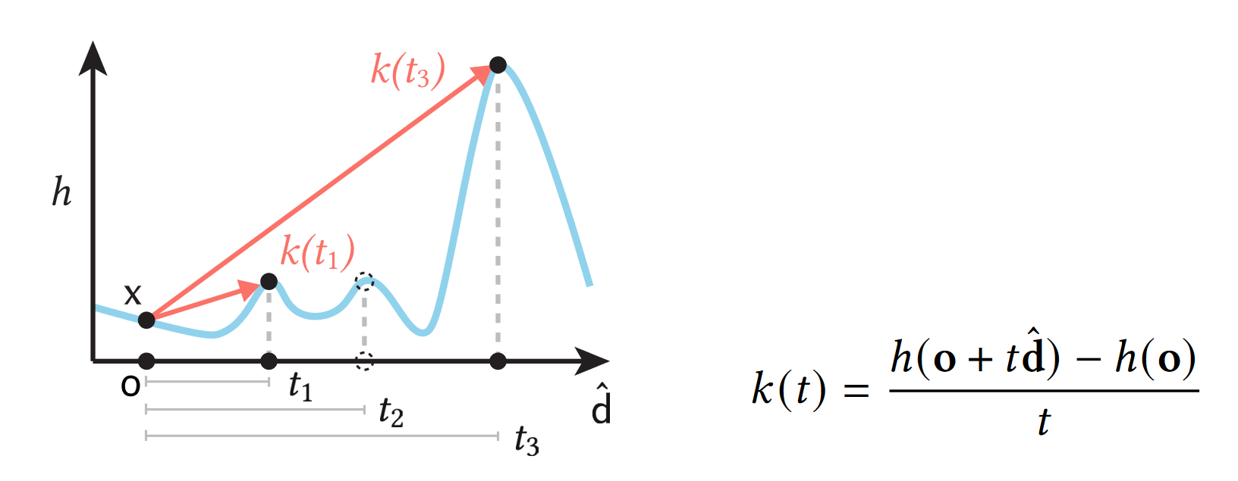
ACCELERATE DISCONTINUITY SEARCHING
Lower, further discontinuities are blocked by near higher discontinuities
Optimization: track the current minimum slope during mipmap ray tracing

Slide 20
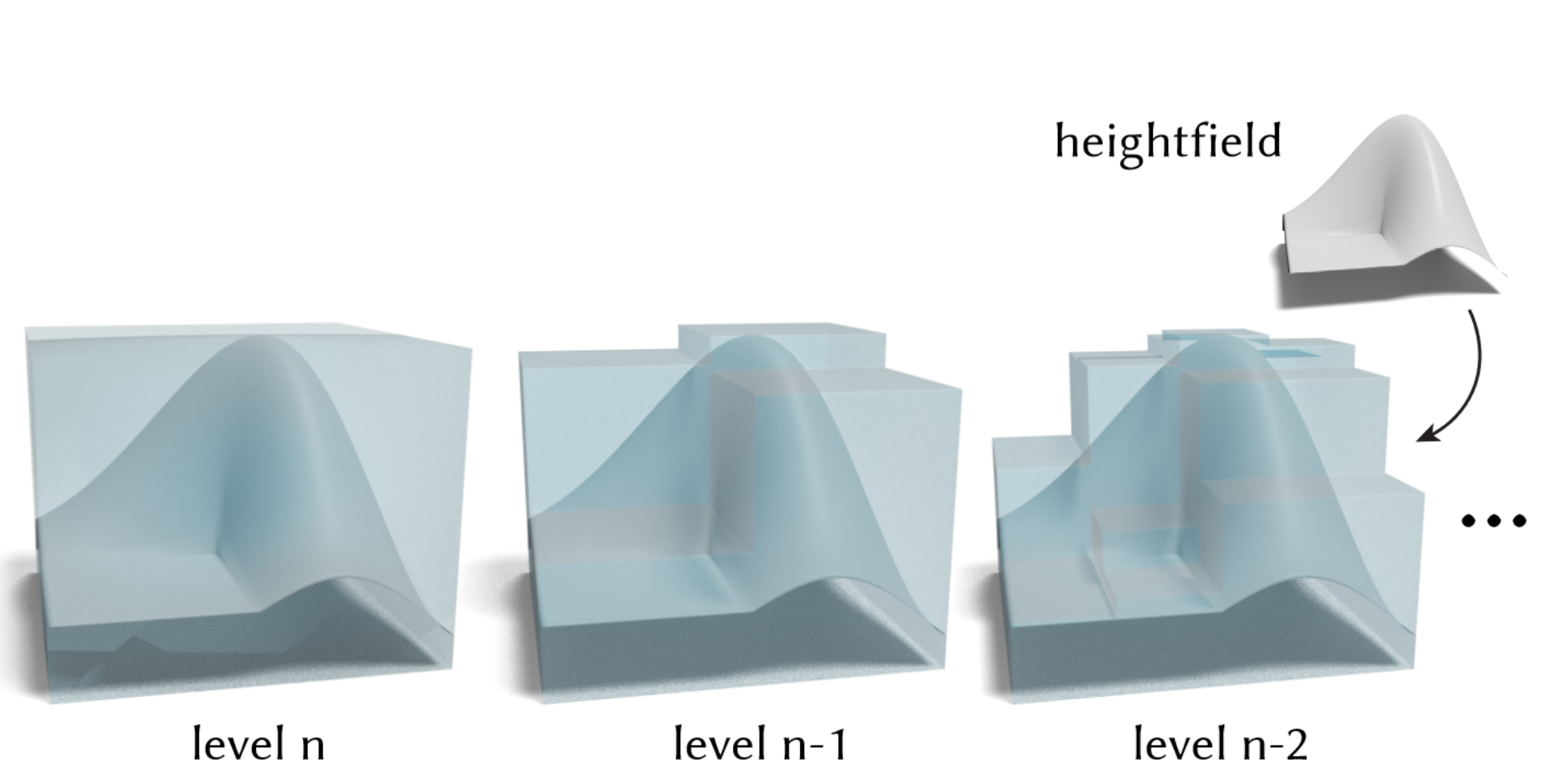
HEIGHTFIELD (BACKWARD) RENDERING [TODO]
Skip regions below the ray with current minimum slope
Accelerate with maximum mipmap [Tevset al. 2008]!

Slide 21
Differentiable heightfield path tracing
Loss
Forward rendering
initial height field
Forward pass
Backward pass
Mipmap accelerated discontinuity searching + reparameterization

Slide 22
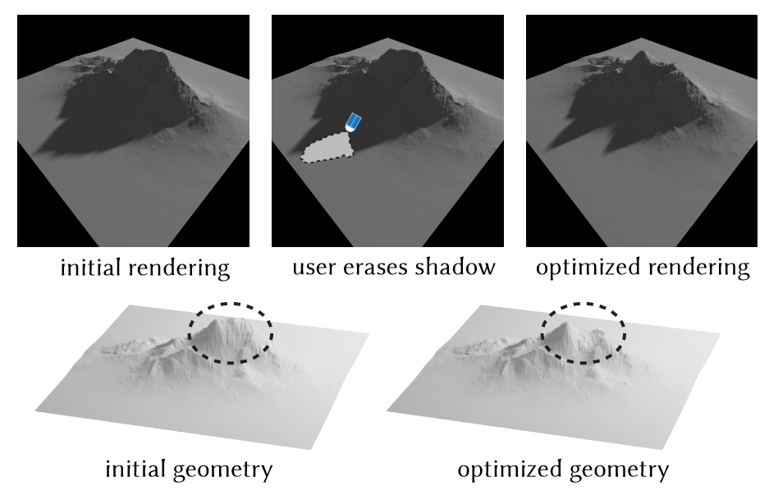
REALTIME SHADOW EDITING
> 300 spp/s

Slide 23
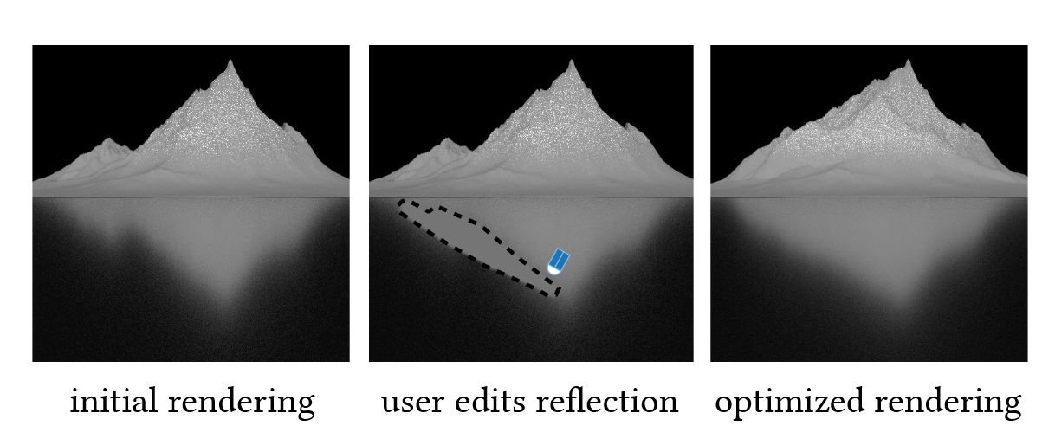
GLOSSY REFLETION EDITING

Slide 24
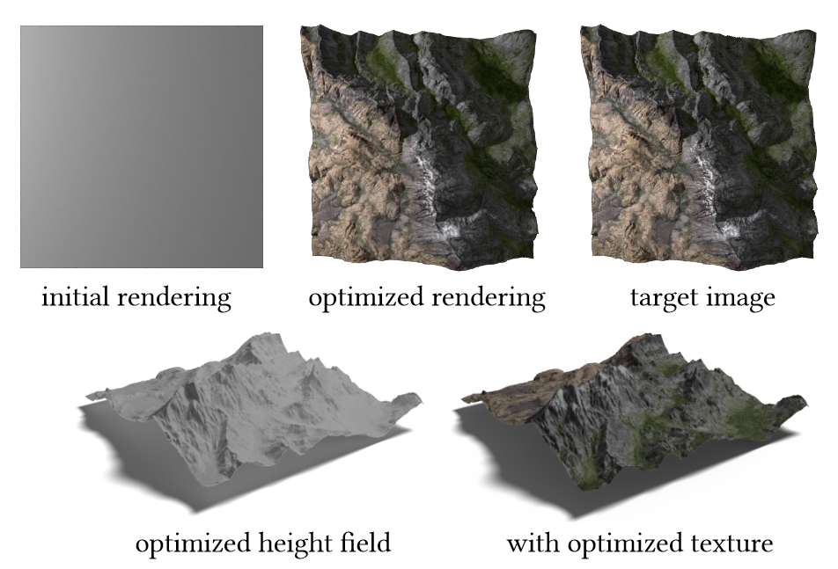
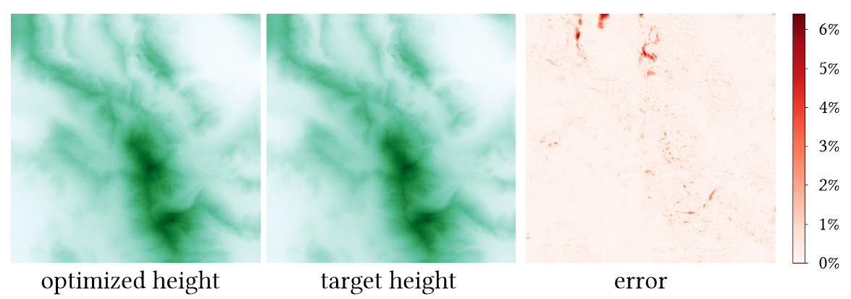
inverse rendering
Multiview surface reconstruction with global illumination

Slide 25
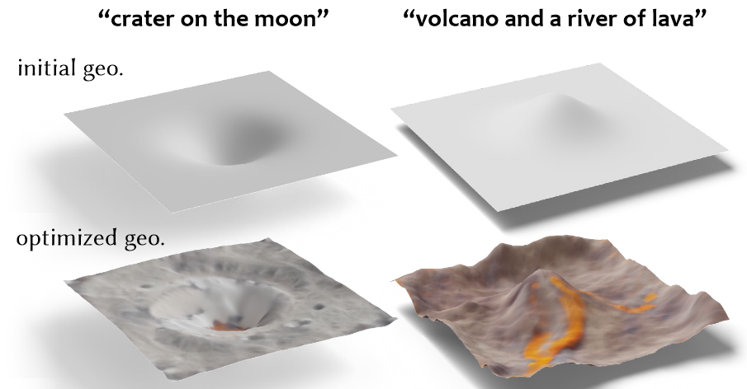
Text-to-shape
Generate heightfield & material from text prompt using CLIP [Radford et al. 2021]

Slide 26
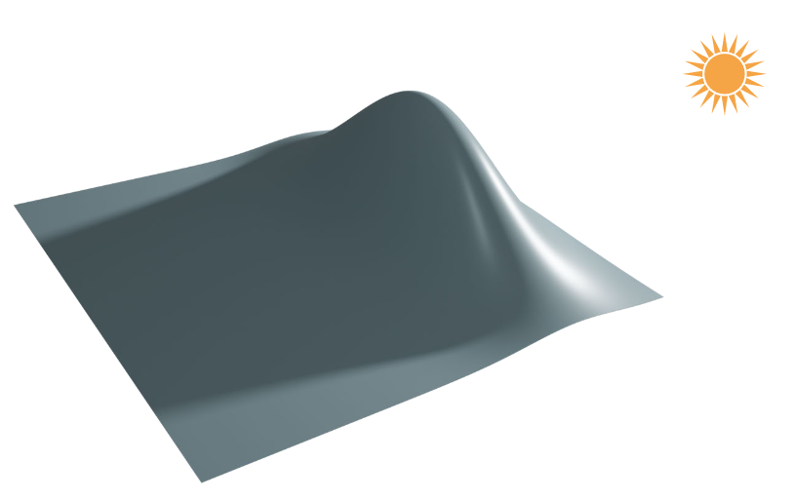
FUTURE WORK
Improving convergence rate for glossy material
Improving performance where scene has few discontinuities
Explore more interactive applications with differentiable renderers
Smooth heightfield with few discontinuities

Slide 27
ACKNOWLEDGEMENT
THANK YOU!
Xiaochun Tong
xtong@uwaterloo.ca

